Slide 1
Python Functions

Slide 2
Agenda
User-Defined Functions
Function Arguments
Variable Scope
Lambda Function
Recursive Function

Slide 3
User-Defined Functions

Slide 4
Built-in functions
Built-in functions are those that are already defined in the Python library

Slide 5
User-defined functions
A function that a user defines in a program is known as user defined function
A user can give any name to a user-defined function. However a function name should not have space or special character
Note: You cannot use the Python keywords as function name

Slide 6
The def keyword
In python, a user-defined function is created using the def keyword, followed by the function name.

Slide 7
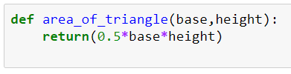
Defining the user-defined function
The keyword ‘def’
Step 1: Declare the function with the Python keyword def followed by a function name desired by the user
Step 2: Write the arguments inside the parentheses of the function
Step 3: End the declaration with a colon
Step 4: Add the program statements that need to be executed
Step 5: End the function. Note a function can be ended with or without a return statement
The function name
The value to be returned
The input parameters

Slide 8
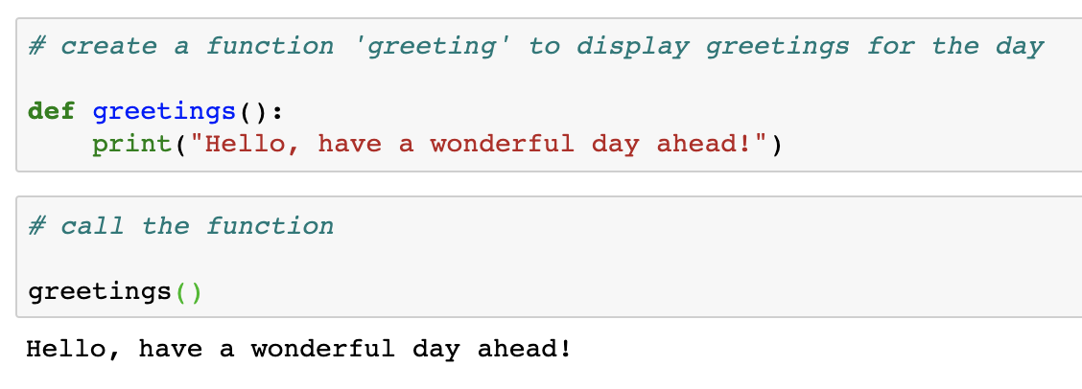
Write your first function using the def keyword
Example

Slide 9
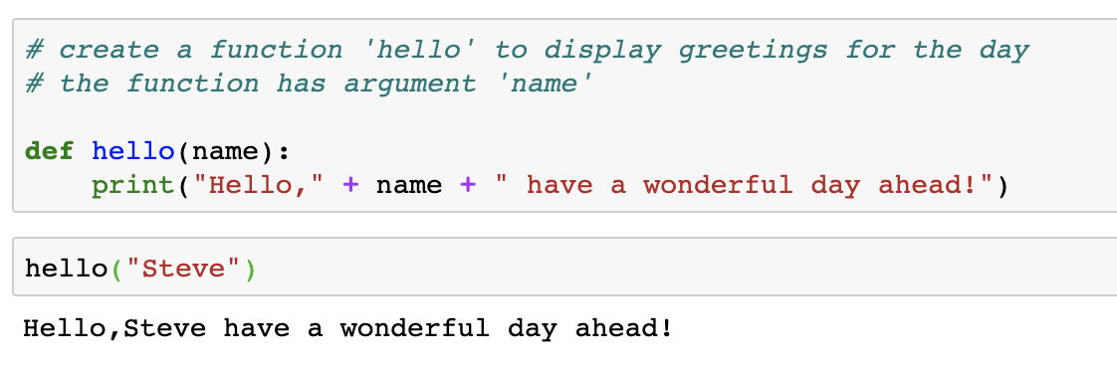
Write a function with an argument
Example

Slide 10
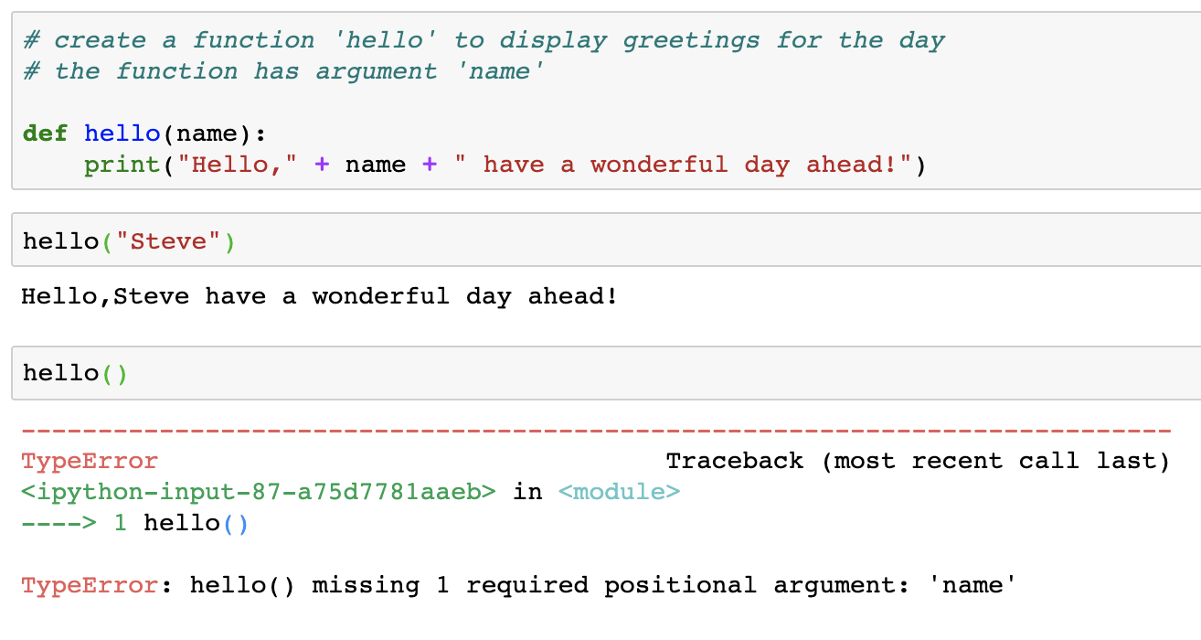
Calling the function without passing argument
When we declare a function that expects input argument, we should pass the required value
If we do not pass the required value, the function will throw an error

Slide 11
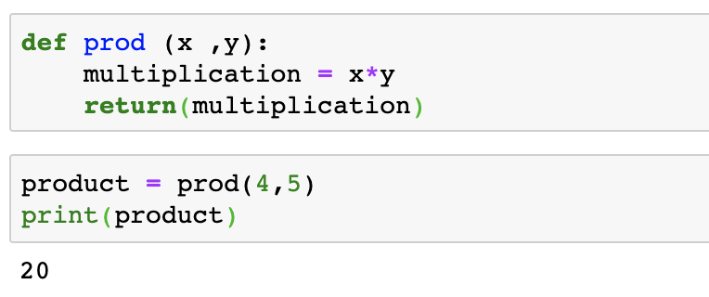
A function with return

Slide 12
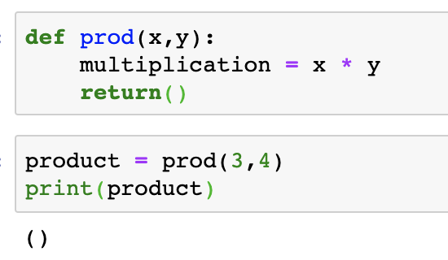
A function without any return value
Note: We use the return keyword in the function but we do not mention what to return. Hence the function returns no value

Slide 13
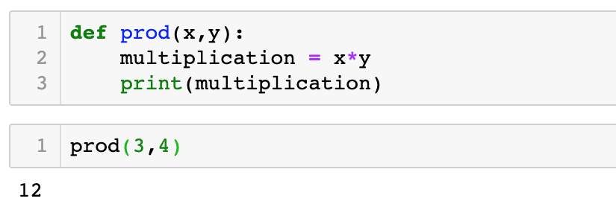
A function without return keyword
Note: When We don't use the return keyword in the function, it will just execute the statements inside that function

Slide 14
Function Arguments

Slide 15
Types of function arguments
Required Arguments
Keyword Arguments
Default Arguments
Variable-Length Arguments

Slide 16
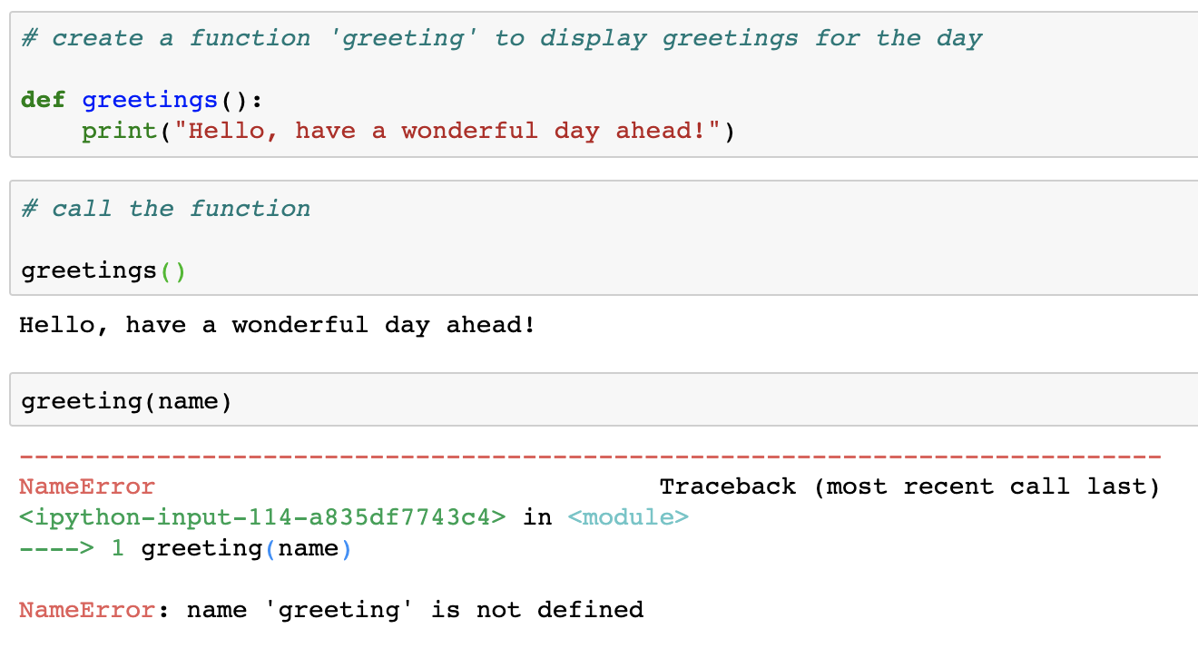
Required Arguments
In case, if the function does not requires the argument and is passed it will throw an error

Slide 17
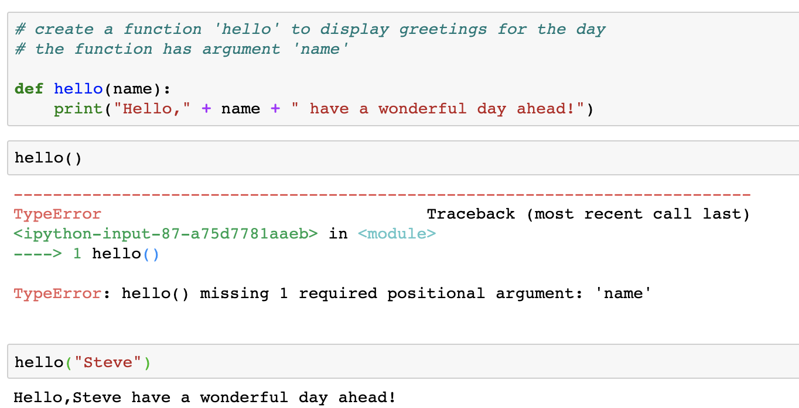
Required Arguments
In case, if the function requires the argument and is not passed it will throw an error

Slide 18
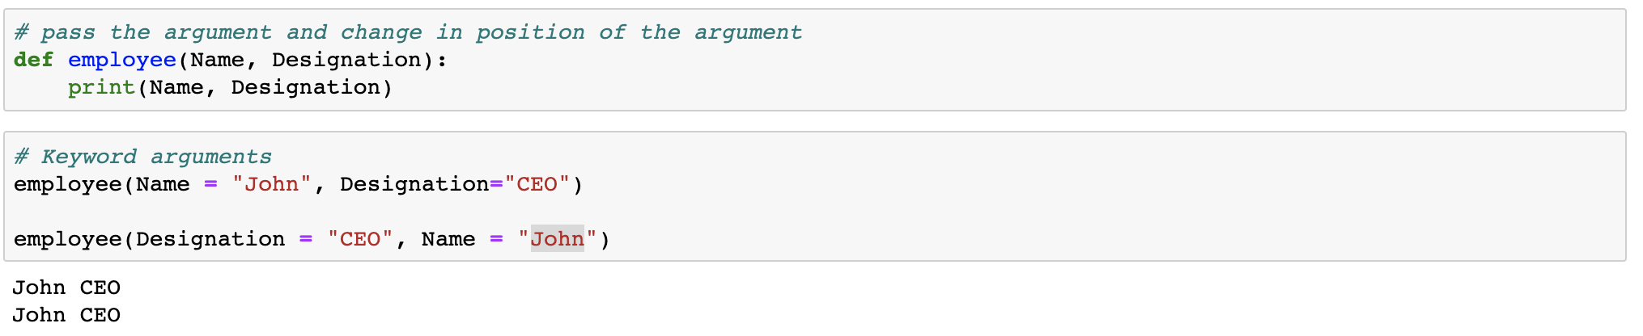
Keyword Arguments
The arguments have names assigned to them. In the below example, we have Name & Designation as the named parameters. We pass ‘John’ as Name and ‘CEO’ as Designation

Slide 19
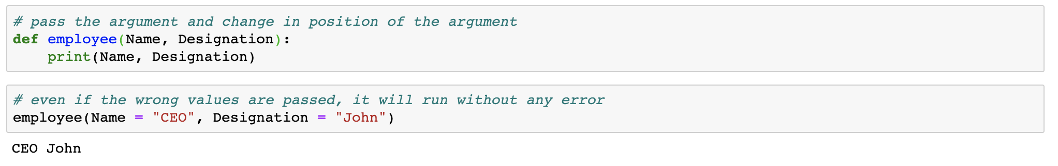
Keyword Arguments
Note: Even if the wrong values are passed, it will NOT throw an error. For example, if we say ‘CEO’ as Name instead of ‘John’, the function will still work but with wrong values

Slide 20
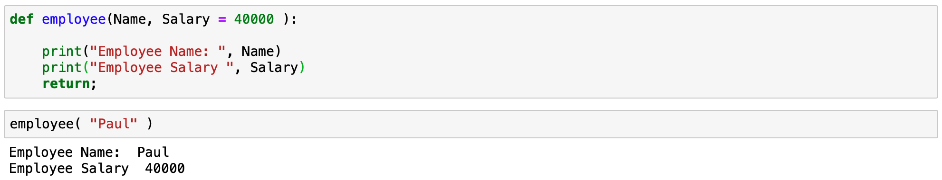
Default Arguments
Note: The function expects 2 arguments - Name and Salary. We have passed a default value for salary. When we call the function, we pass only Name but not Salary. In this case, it will consider the default value for Salary that has been passed when the function was defined

Slide 21
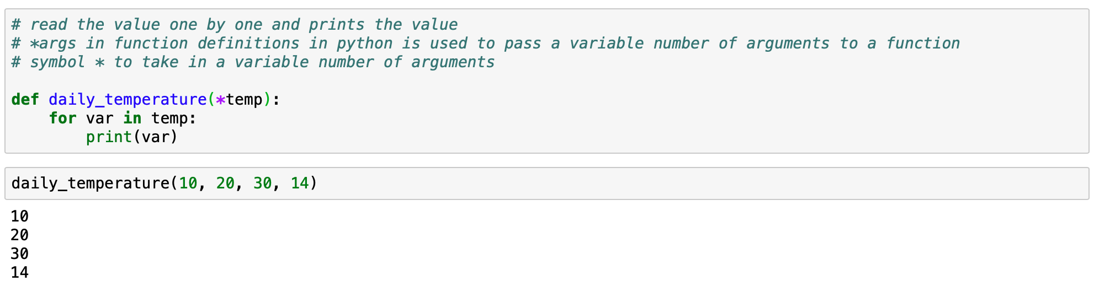
Variable-length arguments using *arg keyword
This helps you in passing variable number of arguments. This is especially helpful when you do not know how many arguments to pass to the function

Slide 22
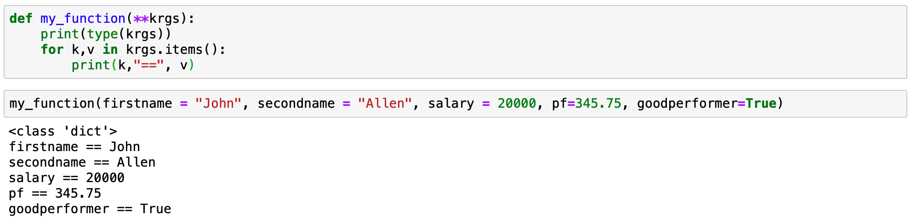
Variable-length keyworded arguments using **kwargs
**kwargs allows the users to pass keyword-ed arguments of variable length to a function. The **kwargs to be used if named arguments are to be passed to a function

Slide 23
Variable Scope

Slide 24
Variable scope
A namespace is a container where names are mapped to variables (Python objects)
A scope defines the hierarchical order in which the namespaces need to be searched in order to obtain the name-to-object mapping
Scope defined the accessibility and lifetime of a variable

Slide 25
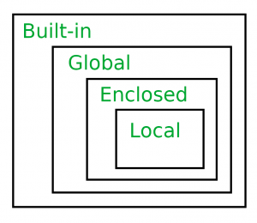
The LEGB rule
In Python, the LEGB rule is used to decide the order in which the namespaces are to be searched for scope resolution
Variable scope hierarchy:
Built-In (B): Reserved names in Python
Global Variable (G): Defined at the uppermost level
Enclosed (E): Defined inside enclosing or nested functions
Local Variable (L): Defined inside a function

Slide 26
Local Scope
Local scope refers to variables defined in a current function. A function will first look up for a variable name in its local scope. If it does not find it there, only then the outer scopes are searched for
Global Scope
If a variable is not defined in local scope, then, it is checked for in the higher scope, in this case, the global scope

Slide 27
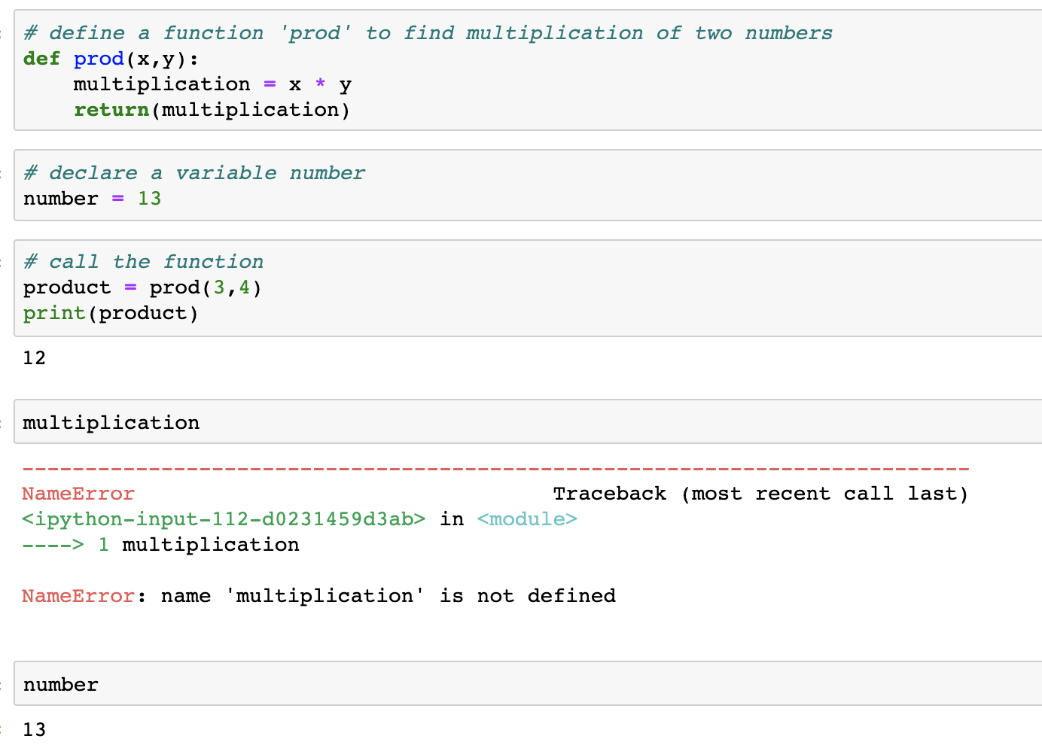
Local and Global Variable
Declaring the variable ‘multiplication’
Declaring the variable ‘number’
Calling the Variable.
It is a local variable
Calling the Variable.
It is a global variable

Slide 28
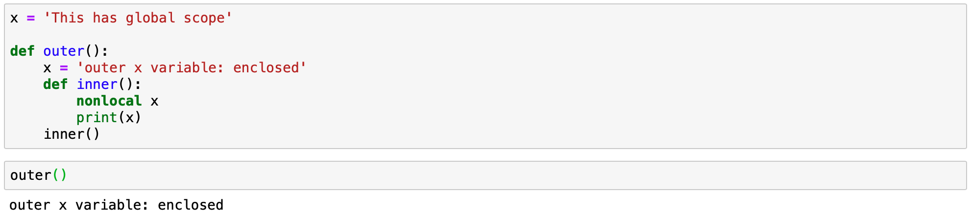
Enclosed Scope
For the enclosed scope, we need to define an outer function enclosing the inner function. Refer to the variable using the nonlocal keyword.

Slide 29
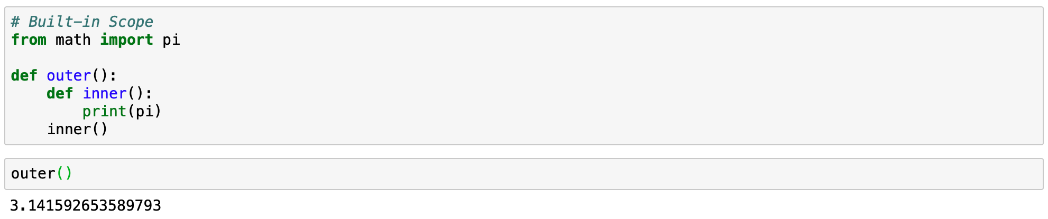
Built-In Scope
If we have not defined a variable and the name of the variable matches with a built-in function from an existing Python module, the function will use the built-in function.

Slide 30
Lambda Function

Slide 31
Lambda function
Lambda functions are anonymous, i.e. to say they have no names
The lambda is a keyword
It is a simple one-line function
No def or return keyword to be used with a lambda function

Slide 32
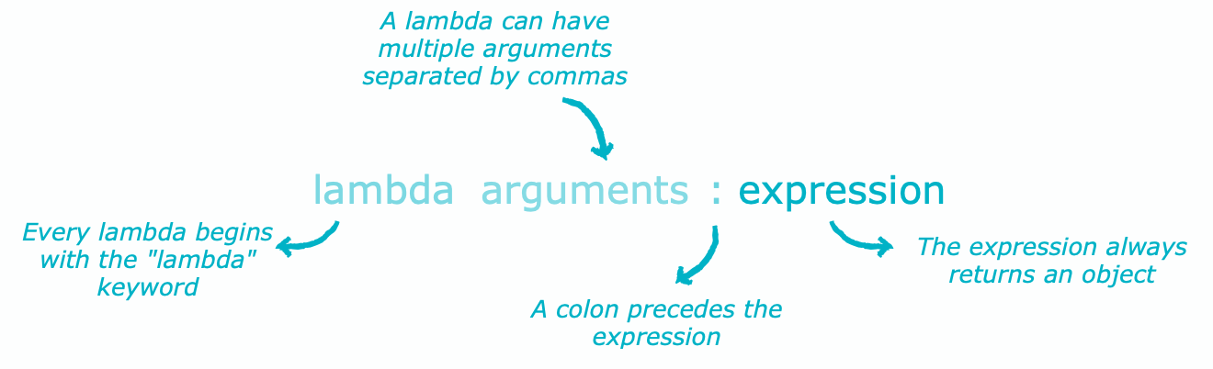
The structure of the lambda function

Slide 33
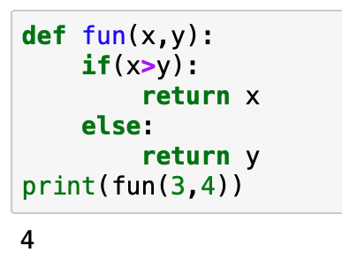
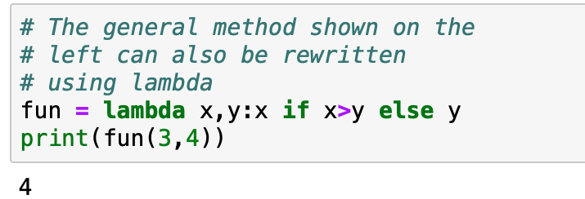
Using lambda function to reduce code size
Normal Python code
Using lambda function

Slide 34
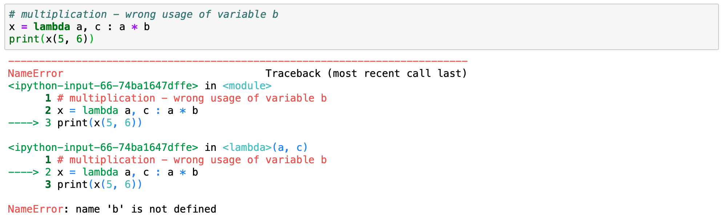
Wrong usage of lambda
You will need to declare the variable which you may use inside the lambda function. In the below example, we use variable, b, without declaring it.

Slide 35


The lambda() with map()
map() functions expect a function_object, in our case a lambda function,and a sequence (iterables, such as list, dictionary, etc.)
It executes the function_object for each element in the sequence and returns a sequence of the elements modified by the function object.
lambda expression (You can also consider any other function )
map(lambda_expression, sequence)
map() function
iterables such as list, tuples, etc. (you can pass multiple iterables)

Slide 36
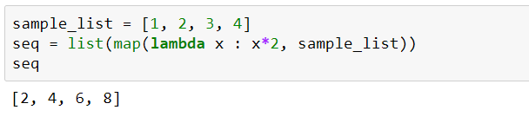
The lambda() with map()
The output is often type-casted into a seq type, as follow:

Slide 37
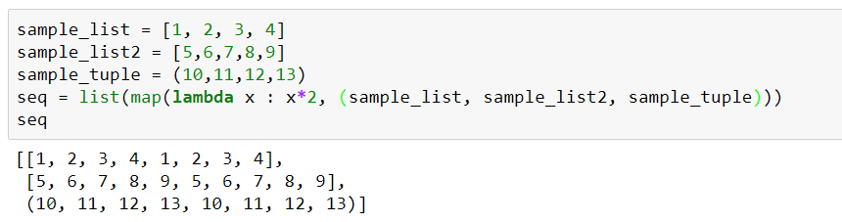
The lambda() with map()
You can pass multiple sequences to the map function as follow:
map(f, li1, li2, li3, …) → applies f to all lists in parallel. That is, first element of result would be f(e1,e2,e3) where its args are first element of each list.

Slide 38
The lambda() with filter()
The filter() function expects two arguments: function_object(lambda) and an iterable.
function_object returns a boolean value and is called for each element of the iterable.
It returns only those elements for which the function_object returns true.
lambda expression (You can also consider any other function )
filter(lambda_expression, sequence)
filter() function
iterables such as list, tuples, etc. (only one iterable as input)

Slide 39
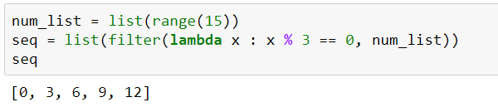

The lambda() with filter()
The output is often type-casted into a seq type, as follow:
Note : Unlike map(), the filter() function can only have one iterable as input.

Slide 40
The lambda() with reduce()
The reduce() function in Python takes in a function and a sequence as argument.
The function is called with a lambda function and a sequence. A new reduced result is returned.
This performs a repetitive operation over the pairs of the sequence object.
lambda expression (You can also consider any other function )
reduce(lambda_expression, sequence)
reduce() function
iterables such as list, tuples, etc. (you can also pass multiple iterables of same type)

Slide 41
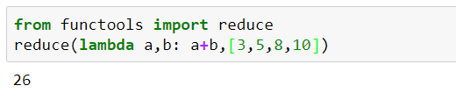
The lambda() with reduce()
Determining the summation of all elements of a list of numerical values by using reduce:
Working:
3
5
8
10
8
16
26

Slide 42
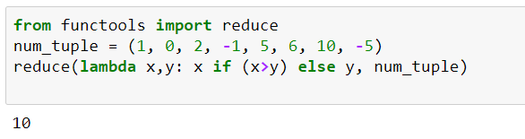
The lambda() with reduce()
Determining the maximum of a list of numerical values by using reduce:
Note: reduce() can only have iterables of same type as input.

Slide 43
The lambda() with accumulate()
The accumulate() function in Python takes in a function and a sequence object as an argument.
The function is called with a lambda function and a sequence object. A new reduced result is returned.
Unlike reduce(), it returns a sequence containing the intermediate results
lambda expression (You can also consider any other function )
accumulate(sequence, lambda_expression)
accumulate() function
iterables such as list, tuples, etc. (you can also pass multiple iterables of same type)

Slide 44
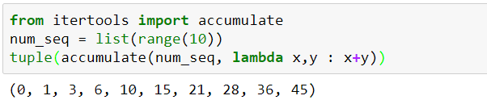
The lambda() with accumulate()
Determining the summation of all elements of a list of numerical values by using accumulate:
The result of above accumulate function can be interpreted as:
p0, p0+p1, p0+p1+p2, …
where, p0, p1, p2,... are elements of the iterable passed

Slide 45
Difference between reduce() and accumulate()
reduce() | accumulate()
The reduce() stores the intermediate result. Returns only the final summation value | The accumulate() returns a list containing the intermediate results. The last number of the list returned is summation of the elements of the list
The reduce(fun,seq) takes function as 1st argument and a sequence object as 2nd argument | The accumulate(seq,fun) takes sequence as 1st argument and function as 2nd argument
The reduce() is defined in “functools” module | The accumulate() is defined in “itertools” module

Slide 46
Recursive Functions

Slide 47
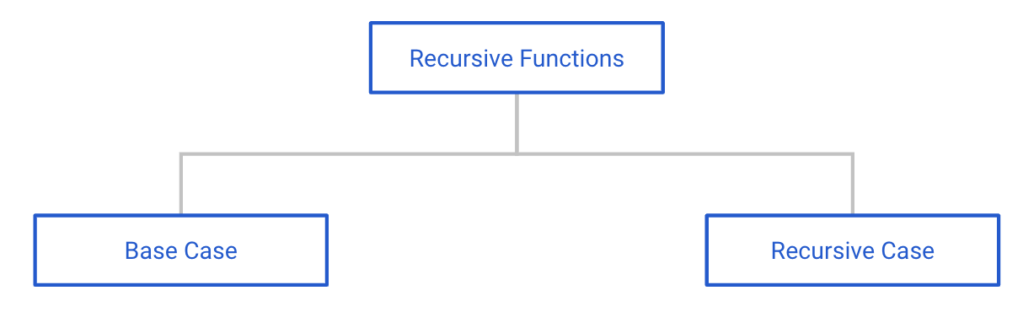
Recursive Function
A recursive function is a function defined in terms of itself via self-referential expressions.
The function will continue to call itself and repeat its behavior until some condition is met to return a result.

Slide 48
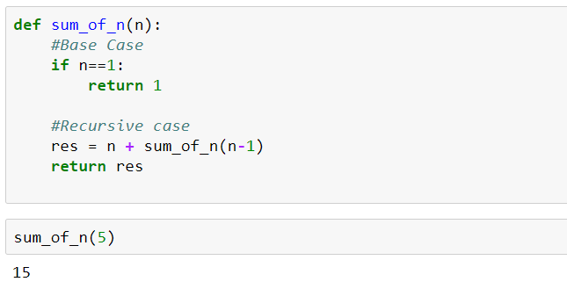
Recursive Function
For example:
A base case is a case, where the problem can be solved without further recursion.

Slide 49
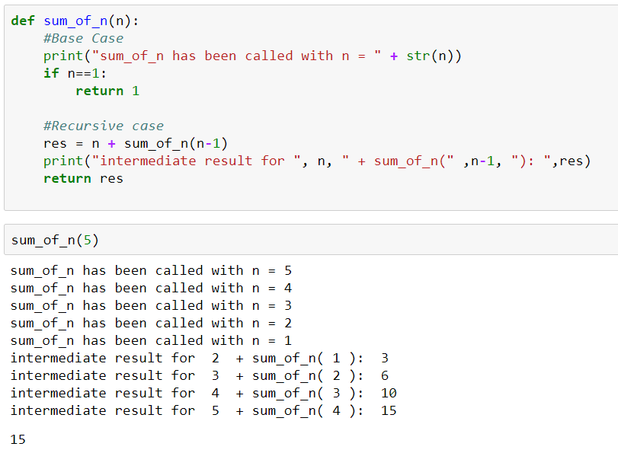
Recursive Function
Let us track how the previously defined recursive function, sum_of_n works by adding two print functions:

Slide 50
Thank You

